Slide 1
Chapter 6: Unions
2023

Slide 2
Chapter 6: Unions
Content:
Unions
Union vs Union all
Union with where clause

Slide 3
What is union
The UNION operator is used to combine the result-set of two or more SELECT statements.
Notes:
The UNION operator is used to combine the result-set of two or more SELECT statements.
Each SELECT statement within UNION must have the same number of columns
The columns must also have similar data types
The columns in each SELECT statement must also be in the same order
Unions are used to retrieve records from multiple tables or to get multiple record sets from a single table.
/*
Get the phone numbers of all shippers customers and suppliers
*/
SELECT CompanyName Phone
FROM Shippers
UNION
SELECT CompanyName Phone
FROM Customers
UNION
SELECT CompanyName Phone
FROM Suppliers
ORDER BY CompanyName;

Slide 4
Union
UNION Rules
• Each query must return the same number of columns.
• The columns must be in the same order.
• Column datatypes must be compatible.
Notes:
By default all duplicates are removed in UNIONs. To include duplicates use UNION ALL in place of UNION.
• In Oracle you can only ORDER BY columns that have the same name in every SELECT clause in the UNION

Slide 5
union
SELECT column_name(s) FROM table1 UNION SELECT column_name(s) FROM table2;
SELECT City FROM Customers UNION SELECT City FROM Suppliers ORDER BY City;
Notes:
The UNION operator is used to combine the result-set of two or more SELECT statements.
Each SELECT statement within UNION must have the same number of columns
The columns must also have similar data types
The columns in each SELECT statement must also be in the same order
Unions are used to retrieve records from multiple tables or to get multiple record sets from a single table.
/*
Get the phone numbers of all shippers customers and suppliers
*/
SELECT CompanyName Phone
FROM Shippers
UNION
SELECT CompanyName Phone
FROM Customers
UNION
SELECT CompanyName Phone
FROM Suppliers
ORDER BY CompanyName;

Slide 6
Union where
SELECT City, Country FROM Customers WHERE Country= ‘Germany’ UNION SELECT City, Country FROM Suppliers WHERE Country= ‘Germany’ ORDER BY City;

Slide 7
UNION vs UNION ALL
UNION
When using UNION command all the selected columns need to be of the same data type. With UNION only distinct values are selected.
UNION ALL
UNION ALL command is equal to UNION command except that UNION ALL selects all the values.
The difference between Union and Union all is that Union all will not eliminate duplicate rows
Instead, it just pulls all the rows from all the tables fitting your query specifics and combines them into a table.
Notes:
A UNION statement effectively does a SELECT DISTINCT on the results set.
[union all actually results in a faster result than union]

Slide 8
Union All
SELECT City FROM Customers UNION ALL SELECT City FROM Suppliers ORDER BY City;
SELECT City, Country FROM Customers WHERE Country= ‘Germany’ UNION ALL SELECT City, Country FROM Suppliers WHERE Country= ‘Germany’ ORDER BY City;

Slide 9
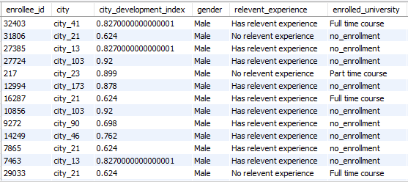
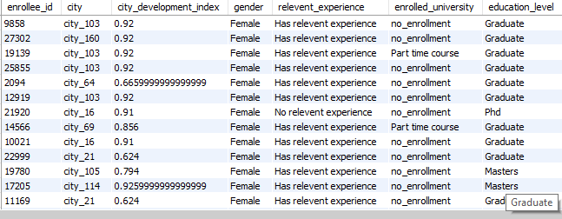
Union (use all 3 tables)
Run a query to compile a view of the males, females and unknown applicants
Run a query to compile a view of everyone who attended a full-time course, whether they entered their gender or not
HR_M
HR_F
Notes:
Schema – HR
Tables – HR_M / HR_F / HR_unknown
select * from HR_F
union
select * from HR_M
union
Select * from HR_unknown;
select * from HR_F
where enrolled_university like 'Full time%’
Union
select * from HR_M
where enrolled_university like 'Full time%’
union
Select * from HR_unknown
where enrolled_university like 'Full time%';

Slide 10
Union
Get all the country names from the tables countries and countriesother into one table
Get all the country names from the tables countries and countriesother into one table, ensure that there are no duplicates.
Get the first 5 country name and number of prices for all the countries
Get the name of the countries from both table only if the percentage of prizes won by males is 100%
Nobel
Notes:
1. select country from countries
Union all
select country from countriesother
2. select country from countries
Union
select country from countriesother
3. select top 5 Country,Number_of_prizes from Countries
union
select top 5 country,Number_of_prizes from Countriesother
4. select Country from Countries
where percentage_prizes_won_by_men = '100%'
group by Country
union
select country from Countriesother
where percentage_prizes_won_m like '100%'
group by Country

Slide 11
Union Additional Practice
Get all the data from the tables.
Get all the data from the tables if the students are male.
Get all the data from table 1 if the students are females and all data from table 2 if they are above 15 years.
Auditions
Notes:
1. select country from countries
Union all
select country from countriesother
2. select country from countries
Union
select country from countriesother
3. select top 5 Country,Number_of_prizes from Countries
union
select top 5 country,Number_of_prizes from Countriesother
4. select Country from Countries
where percentage_prizes_won_by_men = '100%'
group by Country
union
select country from Countriesother
where percentage_prizes_won_m like '100%'
group by Country

Slide 12
Union Additional Practice
Produce a result with orders with quantities greater than 500.
Produce a result of all the different product types you can order.
produce a result with all orders that happened on the third month of the years.
produce a result with all the product names and quantiles that were ordered between 2021 AND 2023.
produce a result showing all the orders made by orderID 11.
produce a result with all products ordered beginning with a ‘C’
Shopdata
Notes:
1. select country from countries
Union all
select country from countriesother
2. select country from countries
Union
select country from countriesother
3. select top 5 Country,Number_of_prizes from Countries
union
select top 5 country,Number_of_prizes from Countriesother
4. select Country from Countries
where percentage_prizes_won_by_men = '100%'
group by Country
union
select country from Countriesother
where percentage_prizes_won_m like '100%'
group by Country

